Slide 1
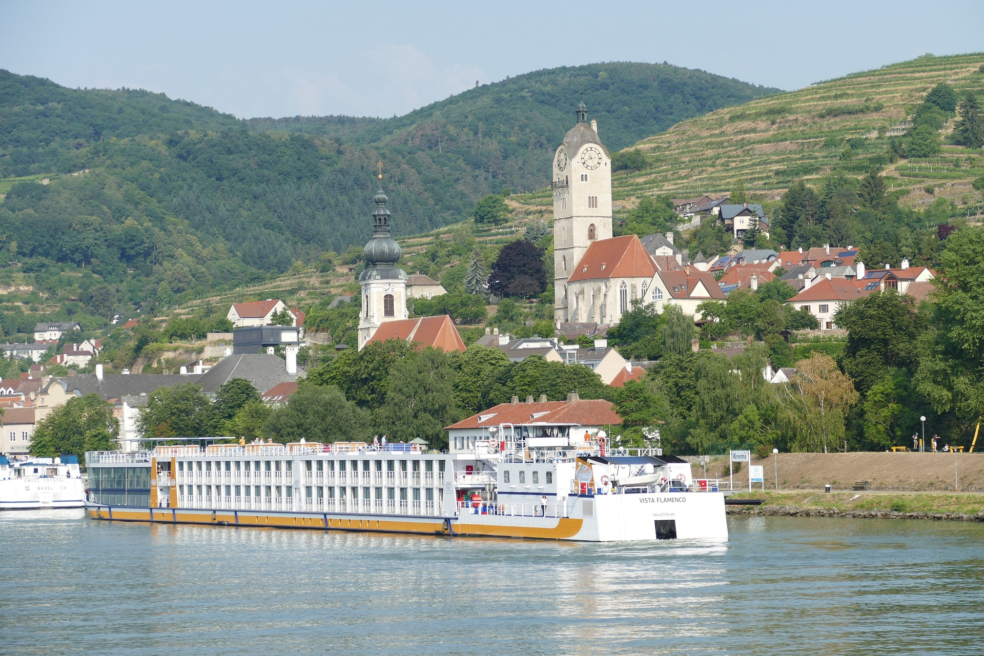
3rd International Conference on Alternative Finance Research
5-6 June 2024
Krems an der Donau, Austria
Submission Deadline: 05.02.2024

Slide 2
Important Dates
Author Notification: 15.03.2024
Early Bird Registration: 15.04.2024
Abstract submission for proceedings: 25.05.2024
Conference presentations files: 29.05.2024
Paper Submission Deadline: 05.02.2024

Slide 3
Submissions
Send submissions to: rotem.shneor(at)uia.no
Mark email title with:
All submissions will be subjected to peer-review
“ICAFR Submission”

Slide 4
Author Guidelines
Full length papers only: Do not submit abstracts.
Length: Manuscript should be no longer than a maximum of 30 pages (including abstract, manuscript text, references, tables, graphs, and appendixes).
Spacing: double space.
Font: Times Roman (size: 11 points).
First page: includes title + abstract + keywords.
Submit two files: (1) title + full list of authors, their affiliations and contact details; (2) full manuscript without author identification.
Submissions: should be made in either Word Doc or Pdf files only.

Slide 5
Call for papers
Papers addressing all issues related to alternative finance are invited, which includes but not limited to, research focused on the following:
Equity Crowdfunding.
Revenue and Profit-Sharing crowdfunding.
Initial Coin Offerings (ICOs).
Security Token Offerings (STOs).
Crowdlending, P2P Lending, and Digital Lending.
Crowdfunded debt-based securities, debentures, and mini-bonds.
Digital Invoice Trading.
Real Estate Crowdfunding.
Crowdfunded insurance
Islamic Finance.
Reward crowdfunding.
Donation Crowdfunding
Digital Patronage.
Charitable Fundraising via Social Media.
Community Shares and Cooperatives.
Prosocial Lending.
Microfinance.
Savings Groups.

Slide 6
Potential Themes
Papers addressing all issues related to alternative finance and/or crowdfunding are invited. These may include, but are not limited to, research focused on the following:
*** Note: reference to crowdfunding may apply to various models of alternative finance ***
Psychology and cognition in crowdfunding behavior.
Factors impacting investor behavior in investment crowdfunding (equity, lending, etc.).
Factors impacting backer behavior in non-investment crowdfunding (reward, donation, etc.).
Risk mitigation in crowdfunding practice within and across models.
Roles of social capital, network relationships, and trust in crowdfunding adoption, practice, and performance.
Creation, leverage, and impact of trust in crowdfunding.
Gender aspects in crowdfunding adoption, practice, and outcomes.
Drivers of crowdfunding campaign performance and success.
Identification and measurement of crowdfunding outcomes beyond funding raised.
Factors impacting defaults in crowdlending.
Short- and long-term implications of crowdfunding experience on organizations’ performance, corporate governance, reputation, and finances.
Short- and long-term implications of crowdlending on borrower finances and welfare.
Survival, growth, and performance of crowdfunded ventures.
Efficiency and effectiveness of fundraising in crowdfunding vs. traditional channels.

Slide 7
Potential Themes
Papers addressing all issues related to alternative finance and/or crowdfunding are invited. These may include, but are not limited to, research focused on the following:
*** Note: reference to crowdfunding may apply to various models of alternative finance ***
Crowdfunding business model design and development.
Crowdfunding platform design and implications for user experience.
Crowdfunding community structure, governance, dynamics, and their implications.
Crowdfunding platform user profiles, characteristics, and their implications.
Blockchain applications in crowdfunding and their implications.
Cultural aspects in crowdfunding adoption, practice, and outcomes.
Crowdfunding business model design and development.
Blockchain applications in crowdfunding and their implications.
Crowdfunding campaign marketing strategies and their relevance for different campaign objectives, target segments, and industrial sectors.
Crowdfunding platform design and implications for user experience.
Crowdfunding community structure, governance, dynamics, and their implications.
Crowdfunding platform user profiles, characteristics, and their implications.
Cultural aspects in crowdfunding adoption, practice, and outcomes.
Crowdfunding campaign marketing strategies and their relevance for different campaign objectives, target segments, and industrial sectors.

Slide 8
Location
IMC University of Applied Sciences
Piaristengasse 1
3500 Krems an der Donau, Austria
https://www.fh-krems.ac.at/en/
Contact: anna.fornalska@fh-krems.ac.at
Recommended Hotels in Krems
Steigenberger Hotel & Spa Krems
https://hrewards.com/de/steigenberger-hotel-spa-krems
Hotel Unter den Linden
https://www.udl.at
Klinglhuber Hotel
https://www.klinglhuber.com/en/rooms-suites/hotel-en
Travel Information
IMC Krems International Welcome Center: welcome@fh-krems.ac.at
Austrian Tourist Information: https://www.austria.info/en
Krems Tourist Information: https://www.krems.info/en
Visa Requirements
For participants with nationalities requiring a visitor visa to enter Austria, letters of invitation will be issued once conference fees have been fully paid.
Getting There
Train Vienna Airport - St. Pölten: approx. 1 hour
Train St. Pölten - Krems an der Donau: approx. 35min (https://shop.oebbtickets.at/en/ticket)
Taxi Airport – Krems: approx. 1 hour, ~ 140 EUR

Slide 9
Registration
Early Bird Registration (until 15.04.2024) |  | Late Registration (after 15.04.2024)
Academic-regular | EUR 380 | EUR 480
Academic-student | EUR 250 | EUR 300
Business-regular | EUR 380 | EUR 480
Non-profit and government organization | EUR 250 | EUR 300
*all prices include VAT
Fees include:
Access for the two-day conference.
Basic lunch serving on both conference days.
Basic refreshments throughout the day on location.

Slide 11
https://www.crowdfunding-research.org/alternative-finance-research-conference-2024

